Slide 1
Farm COnnect
This application based on satellite technology could be used to help farmers improve their crop yields and reduce their costs by providing them with real-time information about weather conditions, soil moisture, crop health, and market prices. The application could use data from a variety of satellites, including weather satellites, to provide farmers with up-to-date information about weather conditions, such as precipitation, temperature, and wind speed. The application could also use data from satellites equipped with multispectral and hyperspectral sensors to provide farmers with information about soil moisture, crop health, and the presence of pests and diseases.
The application could also use data from satellites equipped with GPS to provide farmers with information about the location of their fields and the location of nearby markets. This would enable farmers to make more informed decisions about when to plant, when to harvest, and where to sell their crops. The application could also include a feature that allows farmers to share information with each other, such as crop prices, weather conditions, and pest and disease outbreaks.
Additionally, the application could include a feature that allows farmers to submit their crop data to a central database, which could be used to generate reports and provide useful insights for farmers. This data could also be used by agricultural researchers and policy makers to identify trends, patterns and areas that need attention.

Slide 2
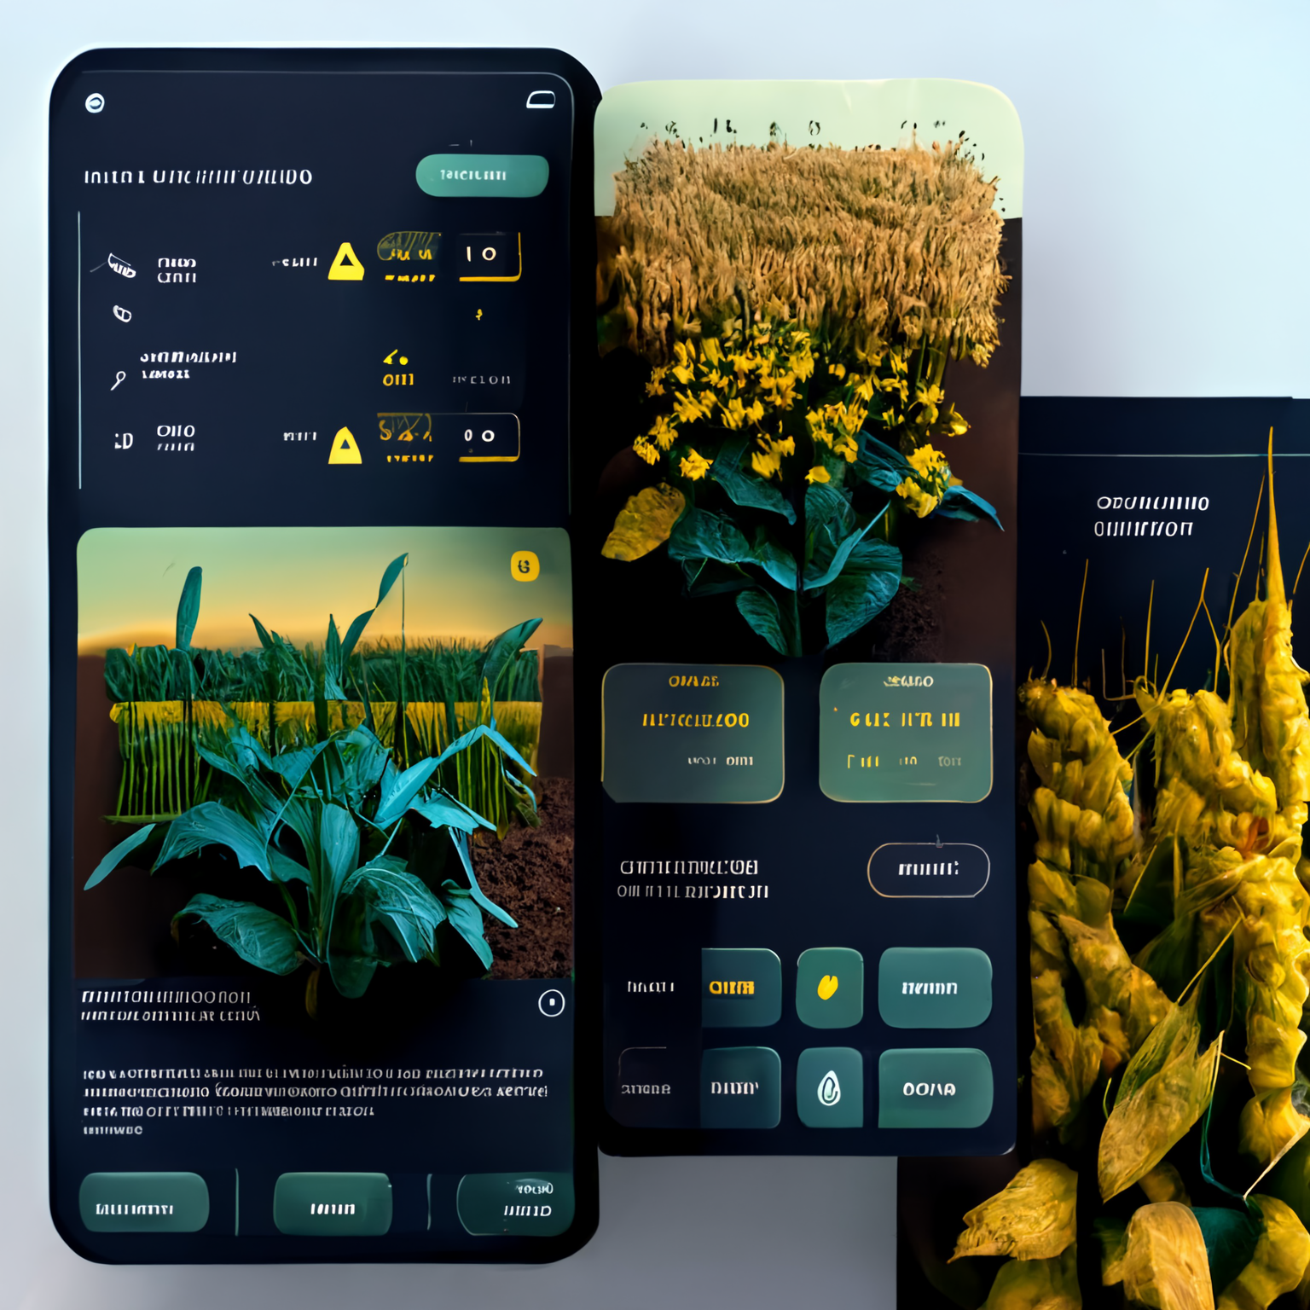
Problem Statement
Farmers often have leftover pesticides, seeds, fertilizers, and Agricultural equipment that they cannot use, which can be wasteful and costly. At the same time, other farmers may need access to these products but cannot afford to buy them at market prices.
We are connecting farmers through our platform, through which they can exchange ideas and share unused pesticides and seeds.

Slide 3
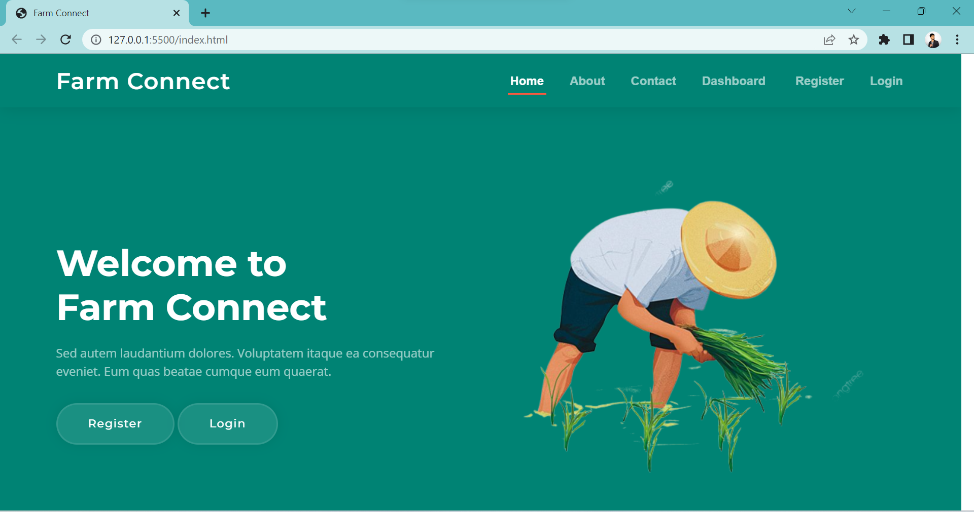
Solution Overview
Connecting farmers to resell their unused pesticides, fertilizers, and agricultural equipment, the proposed solution could be to develop an application-based platform to create profiles and list unused items as well as new products for sale.

Slide 4
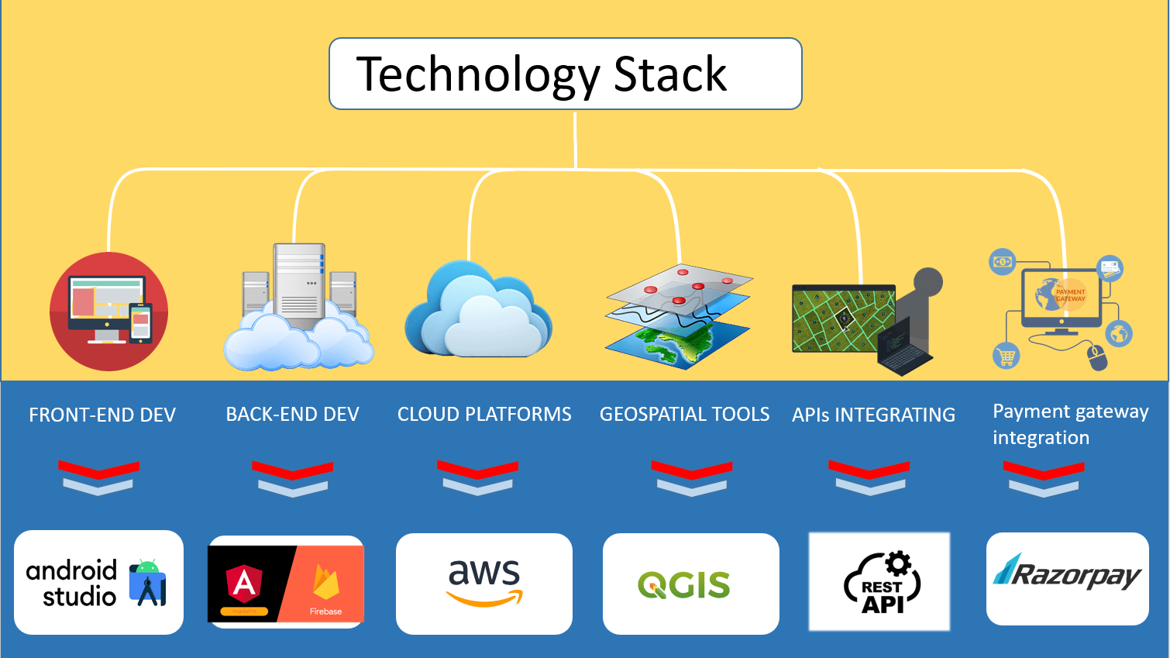
Tech Stack

Slide 5
Key Features
Precision agriculture
A remote sensing application for precision agriculture could use satellite imagery and data analysis to help farmers optimize crop yields .
Environmental monitoring
A remote sensing application for environmental monitoring could use satellite imagery and data analysis to track changes in land use, vegetation, and water bodies over time .
Disaster response
A remote sensing application for disaster response could use satellite imagery and data analysis to quickly identify areas affected by natural disasters and sends the alerts the upcoming disasters .
Building a community for farmers
Furthermore, the application will include a feature for farmers to communicate with each other, share information, and learn from their peers, thus increasing their collaboration and knowledge sharing.

Slide 6
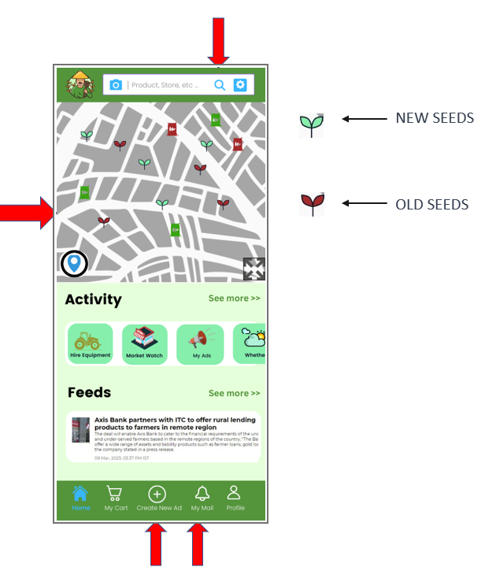
Impact
No improper Disposal of unused pesticides and seeds that can hamper the environment and lead to climate change
The application gives information of climate change , emergency disaster alerts, good user interface, nice user experience
The users will get the alerts and the information direct on the notification calls.
The system focuses on improving the rate of productivity of the farming and aims to assist the farmers in need.
The personal phone notifications and alerts are a strong supporting tool in improving profitable farming strategies.

Slide 7
Thank YOu

